Slide 1
Computer security: terminology and basic concepts
lecture 1

Slide 2
We will learn:
1. General terminology of Computer Security
2. Concepts of Security:​ Confidentiality, Integrity, Availability​
3. Relation between Vulnerabilities, Threats and Controls​
4. Classification and motivation of Attackers​
5. How to React to an Exploit?​
6. Methods of Defense​ - types of controls
7. Principles of Computer Security​

Slide 3
What security is about?​
Security is about protection of assets​
Prevention​
take measures that prevent your assets from being damaged (or stolen)​
Detection​
take measures so that you can detect when, how, and by whom an asset has been damaged​
Reaction​
take measures so that you can recover your assets​

Slide 4
Example​s
Prevention​
encrypt your order and card number, enforce merchants to do some extra checks, using PIN even for Internet transactions, don’t send card number via Internet ​
Detection​
an unauthorized transaction appears on your credit card statement​
Reaction​
complain, dispute, ask for a new card number

Slide 5
Terminology
Computer Security​
2 main focuses: Information and Computer itself​
tools and mechanisms to protect data in a computer ( an automated information system), even if the computers/system are connected to a network​
tools and mechanisms to protect the information system itself (hardware, software, firmware )​
Against?​
against hackers (intrusion)​
against viruses​
against denial of service attacks​
all types of malicious behavior

Slide 6
Terminology
Network and Internet Security​
measures to prevent, detect, and correct security violations that involve the transmission of information in a network or interconnected networks​

Slide 7
Terminology
Adversary (threat agent)
Attack
Countermeasure
Risk
Security policy
Asset (system resource)
Threat
Vulnerability

Slide 8
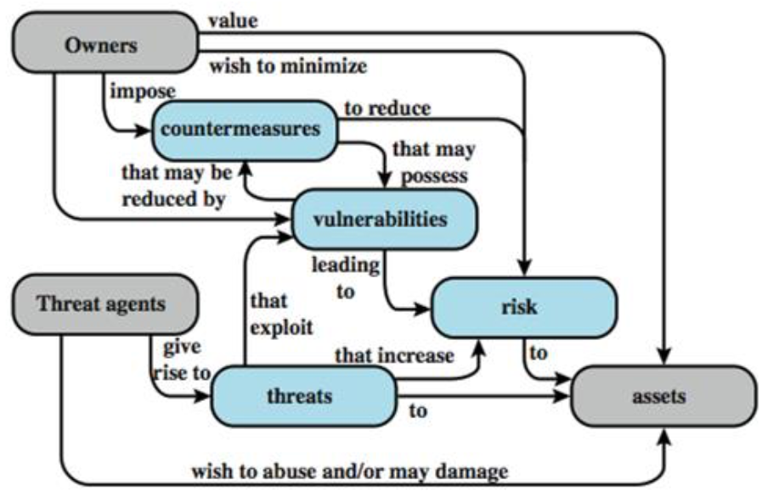
Security Concepts and Relationships

Slide 9
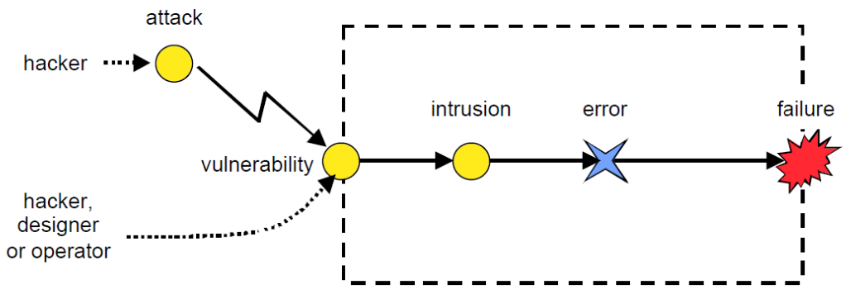
Attack-Vulnerability-Intrusion-Error-Failure model

Slide 10
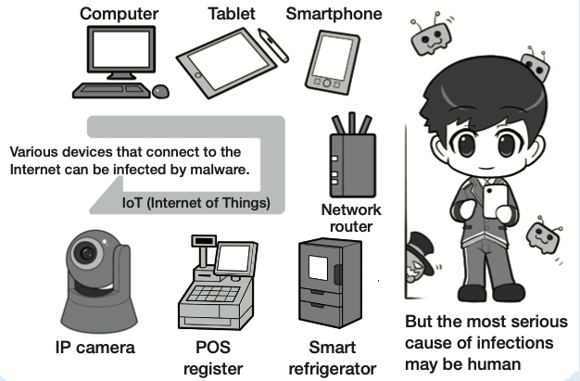
What we have to protect?

Slide 11
Key Security Concepts
• Confidentiality
– Preserving authorised restrictions on information access and disclosure, including means for protecting personal privacy and proprietary information
• Integrity
– Guarding against improper information modification or destruction, including ensuring information nonrepudiation and authenticity
• Availability
– Ensuring timely and reliable access to and use of information

Slide 12
Confidentiality
“Need to know” basis for data access​
How do we know who needs what data?​
Approach: access control specifies who can access what​
​
How do we know a user is the person she claims to be?​
Need her identity and need to verify this identity​
Approach: identification and authentication​
​
“Need to access/use” basis for physical assets​
E.g., access to a computer room, use of a desktop​
​
Confidentiality is:​
difficult to ensure​
easiest to assess in terms of success (binary in nature: Yes / No)​

Slide 13
Integrity
Integrity vs. Confidentiality​
Concerned with unauthorized modification of assets (= resources)​
Confidentiality - concered with access to assets​
Integrity is more difficult to measure than confidentiality​
Not binary – degrees of integrity​
Context-dependent - means different things in different contexts​
Could mean any subset of these asset properties:​
{ precision / accuracy / currency / consistency / ​
meaningfulness / usefulness / ...}​

Slide 14
Availability
​
We can say that an asset (resource) is available if:​
Timely request response​
Fair allocation of resources​
Fault tolerant (no total breakdown)​
Easy to use in the intended way​
Provides controlled concurrency (concurrency control, deadlock control, ...)​

Slide 15
How to Balance?
Example 1: Confidentiality vs. Integrity + Availability
Disconnect computer from Internet to increase confidentiality​
Availability suffers, integrity suffers due to lost updates​
Example 2: Integrity vs. Confidentiality+Availability ​
Have extensive data checks by different people/systems to increase integrity​
Confidentiality suffers as more people see data, availability suffers due to locks on data under verification)​

Slide 16
Vulnerabilities, Threats, and Controls​
Understanding Vulnerabilities, Threats, and Controls​​
Vulnerability = a weakness in a security system​
Threat = circumstances that have a potential to cause harm​
Controls = means and ways to block a threat, which tries to exploit one or more vulnerabilities​
​
Example - New Orleans disaster (Hurricane Katrina)​
Q: What were city vulnerabilities, threats, and controls?​
A: Vulnerabilities: location below water level, geographical location in hurricane area
Threats: hurricane, dam damage, terrorist attack
Controls: dams and other civil infrastructures, emergency response plan

Slide 17
Attack
Attack (implementation of a vulnerability/threat combination)​
= exploitation of one or more vulnerabilities by a threat; tries to defeat controls​
Attack may be:​
Successful (exploit)​
resulting in a breach of security, a system penetration, etc.​
Unsuccessful​
when controls block a threat trying to exploit a vulnerability​

Slide 18
Levels of Vulnerabilities / Threats​
​
for other assets​ (including people using data, software​, hardware​)​
for data​ (including software​)
for software​ (including hardware​)
for hardware​

Slide 19
Hardware Level of Vulnerabilities / Threats​
Add / remove a hardware device​
Ex: Snooping, wiretapping ​
Snoop = to look around a place secretly in order to discover things about it or the people connected with it.
Ex: Modification, alteration of a system​
Physical attacks on hardware => need physical security: locks and guards​
Accidental (dropped PC box) or voluntary (bombing a computer room)​
Theft / destruction​
Damage the machine (spilled coffe)​
Steal the machine​

Slide 20
Software Level of Vulnerabilities / Threats​
​
Software Deletion​
Easy to delete needed software by mistake​
To prevent this: use configuration management software​
Software Modification​
Trojan Horses, Viruses, Logic Bombs, Trapdoors, Information Leaks (via covert channels)
Software Theft​
Unauthorized copying​
​

Slide 21
Types of Malicious Code​
Logic bomb - Malicious code that activates when specified conditions are met. Usually intended to cause denial of service or otherwise damage system resources.​
Trapdoor - A hidden computer flaw known to an intruder, or a hidden computer mechanism (usually software) installed by an intruder, who can activate the trap door to gain access to the computer without being blocked by security services or mechanisms.​
Trojan horse - A computer program that appears to have a useful function, but also has a hidden and potentially malicious function that evades security mechanisms, sometimes by exploiting legitimate authorizations of a system entity that invokes the program. ​

Slide 22
Types of Malicious Code​
Virus - A hidden, self-replicating section of computer software, usually malicious logic, that propagates by infecting (i.e., inserting a copy of itself into and becoming part of) another program. A virus cannot run by itself; it requires that its host program be run to make the virus active.​
Worm - A computer program that can run independently, can propagate a complete working version of itself onto other hosts on a network, and may consume computer resources destructively.​

Slide 23
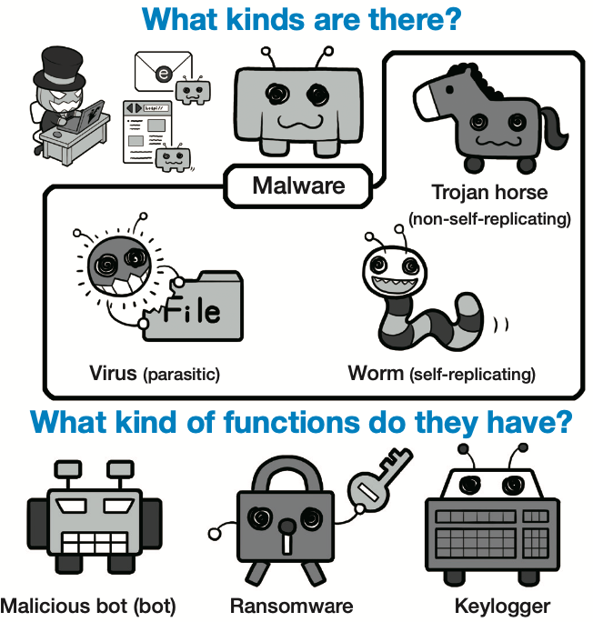
Malware

Slide 24
Data Level of Vulnerabilities / Threats​
How valuable is your data?​
Credit card info, your phone number​
Source code​
Visible data vs. context ​​
Adequate protection​
Cryptography​
Threat of Identity Theft​

Slide 25
Types of Attacks on Data
Disclosure​
Attack on data confidentiality​
Unauthorized modification / deception​
Providing wrong data (attack on data integrity)​
Disruption​
DoS (attack on data availability)​
Usurpation​
Unauthorized use of services (attack on data confidentiality, integrity or availability)

Slide 26
Types of attacks
Attacks will seek to exploit a vulnerability in a system
They may use malware as launching pads or for carrying out an exploit
They may come from inside or outside the system
They may be motivated by a variety of reasons
Other examples of attacks:
Denial of service
Distributed denial service
Phishing
Ransomeware
Cross site scripting
Social engineering

Slide 27
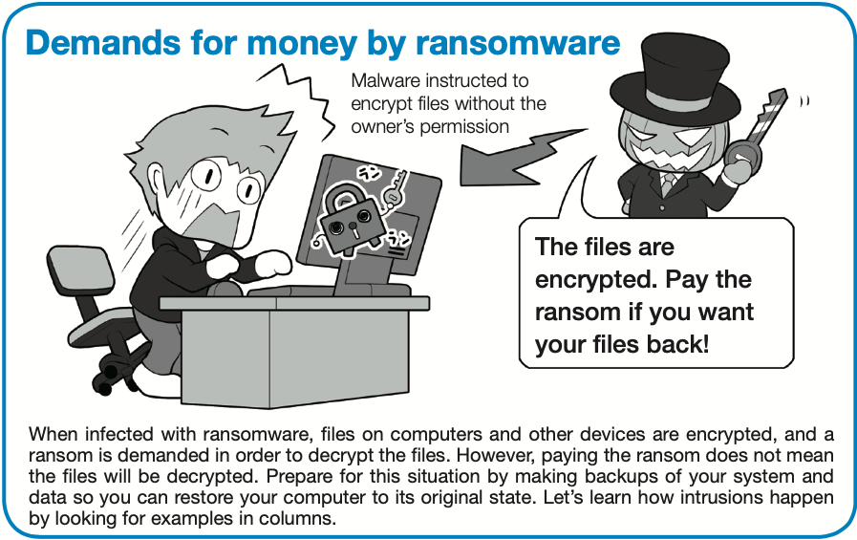

Slide 28
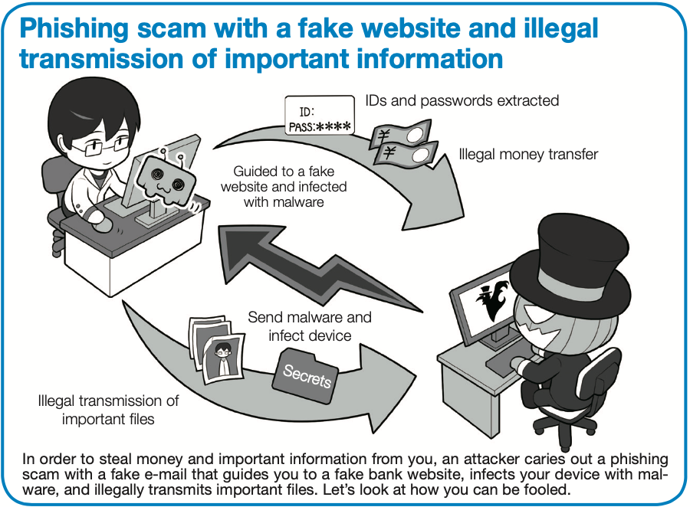

Slide 30
Ways of Attacking Data
Examples of Attacks on Data Confidentiality​
Tapping / snooping​
Examples of Attacks on Data Integrity​
Modification​
Fabrication: replay data -> send the same thing again​ (a computer criminal replays a salary deposit to his account​)
Examples of Attacks on Data Availability​
Delay vs. „full” DoS​
Examples of Repudiation Attacks on Data:​
Repudiation = refusal to acknowledge or pay a debt or honor a contract (especially by public authorities)

Slide 31
Vulnerability/Threats at Other Exposure Points
Network vulnerabilities / threats​
Networks multiply vulnerabilties and threats, due to their complexity and „bringing close” physically distant attackers​ (esp. wireless networks​)
Access vulnerabilities / threats​
Stealing bandwidth​, IP
Malicious physical access​
Denial of access to legitimate users ​
​
People vulnerabilities / threats ​
Crucial weak points in security​
Honest insiders subjected to skillful social engineering​
Disgruntled employees​

Slide 32
Attackers​
Method​ Skill, knowledge, tools, etc. with which to pull off an attack​
Opportunity​ Time and access to accomplish an attack​
Motive​ Reason to perform an attack​

Slide 33
Classification of Attackers​
Types of Attackers - Classification 1​
Amateurs​
Opportunistic attackers (use a password they found)​
Hackers - nonmalicious​
Crackers – malicious​
Career criminals​
State-supported spies and information warriors​
Types of Attackers - Classification 2 (cf. before)​
Recreational hackers / Institutional hackers​
Organized criminals / Industrial spies / Terrorists​
National intelligence gatherers / Info warriors​

Slide 34
Attacker motivations
• Financial
• Political
• Nation state actors (defence or attack; activist/hacktivist groups (e.g. Anonymous
group))
• Military / Strategy
• Nation state actors (defence or attack (Stuxnet, Flame))
• Psychological
• Nation state attackers seeking to cause confusion and doubt in population etc.

Slide 35
Reacting to an Exploit​
An exploit is any attack that takes advantage of vulnerabilities in applications, networks, operating systems, or hardware.
Exploits usually take the form of software or code that aims to take control of computers or steal network data.
​
Report to the vendor first?​
Report it to the public?​
What will be public relations effects if you do/do not?​
Include source code / not include source code?​

Slide 36
Methods of Defense ​
Basic approaches to defense of computing systems​
Prevent attack​: block attack / vulnerability​​
Deter attack​: make attack harder
Deflect attack​: make another target more attractive than this target​
Detect attack​: during or after​
Recover from attack​

Slide 37
How to maintain security?
Keep systems always up-to-date and install security software for protection
Using complex passwords and multi-factor authentication to make intrusion more difficult
Make attacks more difficult by ensuring intrusion takes time and effort (cost)
Patch your psychological security hole (resistance to social engineering)
Download software and apps from trusted sources. Pay attention to permissions

Slide 38
Controls​ (countermeasures)
Encryption​
Software controls​
Hardware controls​
Policies and procedures​
Physical controls ​

Slide 39
Encryption
Primary controls
Original text scambled into ciphertext (enciphered text)​
Protects:​
confidentiality – by „masking” data​
integrity – by preventing data updates​ (checksums included​)
availability – by using encryption-based protocols​ (protocols ensure availablity of resources for different users​)

Slide 40
Software Controls​
Secondary controls – second only to encryption​
Software/program controls include:​
OS and network controls​
OS: sandbox / virtual machine ​
Logs/firewalls, OS/net virus scans​
independent control programs
password checker, virus scanner, IDS (intrusion detection system)​
development controls​
quality standards followed by developers​ (incl. testing​)

Slide 41
Hardware Controls​
Hardware devices to provide higher degree of security​
Locks and cables
Smart cards, hadware keys

Slide 42
Policies and Procedures​
Policy vs. Procedure​
Policy: What is/what is not allowed​
Procedure: How you enforce policy​
Advantages of policy/procedure controls:​
Can replace hardware/software controls​
Can be least expensive​
Be careful to consider all costs​ (help desk costs often ignored for for passwords (=> look cheap but migh be expensive)​)

Slide 43
Physical Controls
Walls, locks​
Guards, security cameras​
Backup copies and archives​
Cables and locks
Natural and man-made disaster protection​ (Fire, flood, and earthquake protection​)

Slide 44
Effectiveness of Controls ​
Awareness of problem​
People convinced of the need for these controls​​
Likelihood of use​
Too complex/intrusive security tools are often disabled​
Overlapping controls​
>1 control for a given vulnerability​
To provide layered defense – the next layer compensates for a failure of the previous layer​​
Periodic reviews​
A given control usually becomes less effective with time​
Need to replace ineffective/inefficient controls with better ones​

Slide 45
Principles of Computer Security
Principle of Easiest Intrusion
An attacker must be expected to use any available means of intrusion.​
The intrusion may not necessarily be by the most obvious means, nor is it necessarily the one against which the most solid defense has been installed.​
​
Principle of Adequate Protection
Computer items must be protected to a degree consistent with their value and only until they lose their value​

Slide 46
Principle of Effectiveness​
Controls must be used—and used properly—to be effective.​
They must be efficient, easy to use, and appropriate.​
​
Principle of Weakest Link
Security can be no stronger than its weakest link. ​
Whether it is the power supply that powers the firewall or the operating system under the security application or the human, who plans, implements, and administers controls, a failure of any control can lead to a security failure.​

Slide 47
Security Video & Tests:
https://www.khanacademy.org/partner-content/nova/cybersecurity/cyber/v/cybersecurity-101
Cyber Security Games & Tests:
https://www.its.ms.gov/Services/Pages/Security-Quizzes-Tests.aspx
Cyber Security Knowledge test:
https://www.pewinternet.org/quiz/cybersecurity-knowledge/
Cyber Security Knowledge Quiz:
https://www.zyxel.com/solutions/Cyber-Security-Knowledge-Quiz-20180508-764380.shtml
Test your knowledge:
https://www.clark-it.com/cyberquiz
How security savvy are you:
http://home.bt.com/tech-gadgets/internet/cyber-security-how-savvy-are-you-quiz-11364119381599

